Slide 1
Internship project FlaixEnergy
Tasks and target

Slide 2
Phase 1-3 (14.05.2018-15.06.2018)
Phase 1 (14.05.2018-16.05.2018)
Literature on energy flexibility
German distribution grid
Phase 2 (17.05.2018 – 31.05.2018)
Using Visual studios and install python packages (pandapower)
Getting the loadflow running
Setting up the data (starting with CIGRE testgrid)
Phase 3 (01.06.2018-15.06.2018)
Compare results with Christophs analysis
Eventually adapt clusters that result from that optimization
Sensitivity analysis
Choose the demonstration timeframe (4 days, 15min intervals)

Slide 3
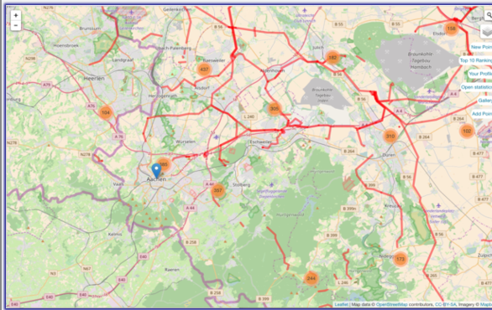
Phase 4 (18.06.2018-07.09.2018)
GUI programming using matlab or python
Take tables and graphics from Christophs work and import
Take line losses, result of OPF, line loadings from pandapower
Target user interface
Input
Output
Winter weekday
Summer weekday
9 AM
Resulting Cluster
Date & Time
Winter weekend
Summer weekend
EEX Price Curve
Local PV
Factor 4x
Local Wind
Factor 2x
Automotive Industry
Degree of load flexibility
Total line loading
Steel Industry
Total line losses
OPF result

